Slide 1

BEALTHY
Design and Implementation of Mobile Applications
2020-2021
Giulia Meneghin: 10488640
Giuseppe Mauri: 10454364

Slide 2

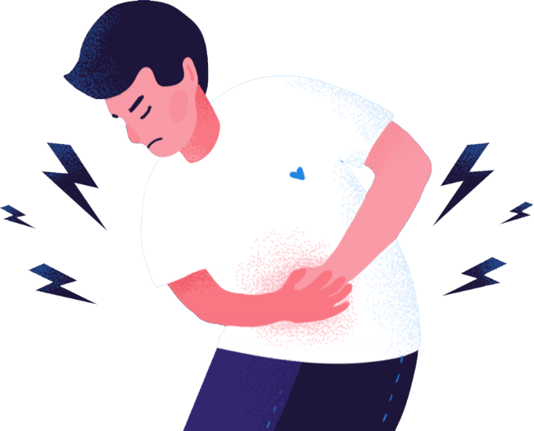
PURPOSE
Find and visualize the correlation between the digestion symptoms and the foods a user consumes

Slide 3



FEATURES
Data history
Statistics
Treatment
Enter and edit data during the day
View analyzed data using graphs
Add and view medical treatment effectiveness

Slide 4



DATA WE NEED
Symptoms
Treatment
Dishes
Intensity
Occurrences
Starting date
Ending date
Mealtime
Frequency
Ingredients
Quantity
Divided by users
Stored online

Slide 5




TWO TIER FAT CLIENT ARCHITECTURE
Asynchronous call
Application Logic
Data Snapshot
CLIENT
REMOTE DATABASE

Slide 6

CLIENT
Made in flutter:
Free and open source framework
Customizable widgets
Cross-platform
Performance
Dynamic status management realized with:
MobX
Provider

Slide 7



DATABASE
Firebase:
NoSql read e write,
Google security
Google authentication
Shared and private data
Open Food Facts:
Open-database
Hundred thousand of products
API searching query
Json response

Slide 8
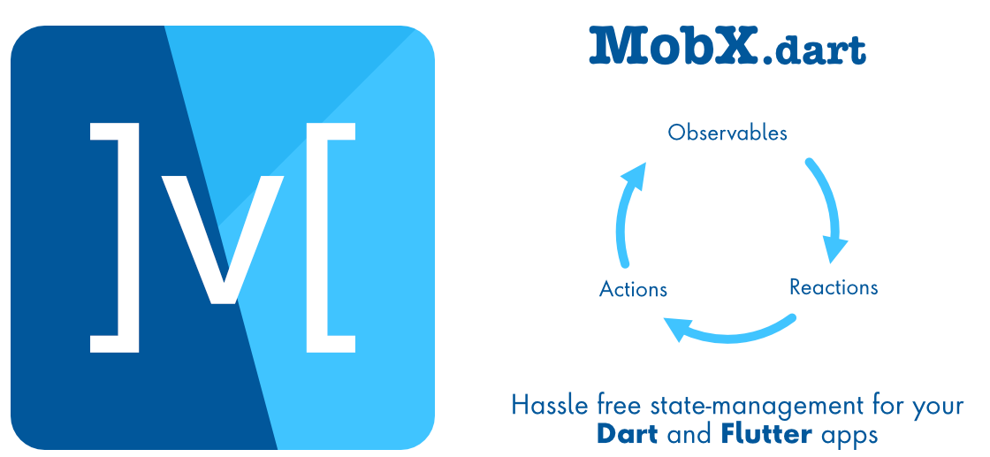


PACKAGES
MobX
FlutterFire
Open Food Facts
State management through the concept of observable data, actions and reactions.
Allows to visualize the changes to the data rebuilding only of the UI containing the interested data using the “Observer" widget”
Authentication via internal firebase service (email/google/github/twitter)
Firebase call to get data from the NoSql database
Set of rules to access only the personal data.
Function the get and save file on the internal storage
Package containing remote APIs to access the database
Search queries already implemented
Method to handle the Json results and save it as a “Product” object

Slide 9
…MORE
Flutter_barcode_scanner
Image
Permission_handler
Image_picker
Camera
Image_cropper
Table_calendar
Intl
Fl_chart
Mockito
Async
Flutter_range_slider
Lit_firebase_auth
Provider
Focused_menu
Path_provider

Slide 10
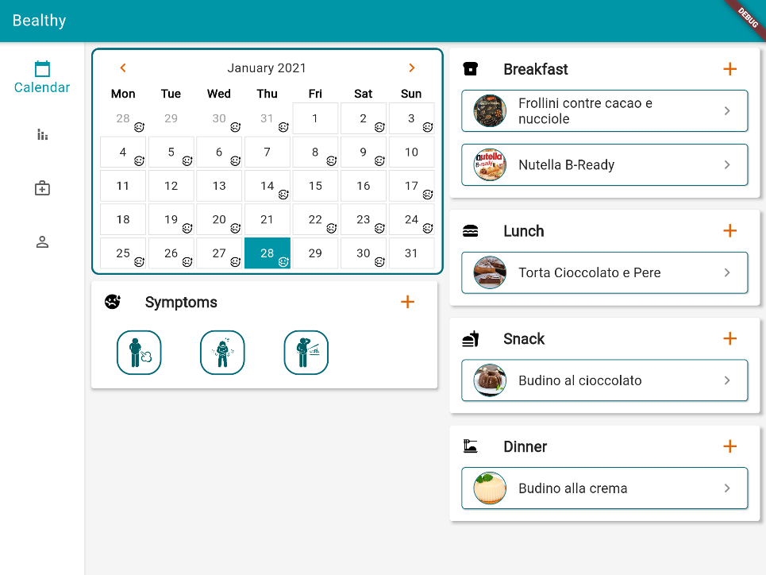
THANKS
NOW THE DEMO!

